Slide 1

Bengaluru– 560 038, Karnataka, INDIA
Presentation on
MICRO CREDIT DEFAULTER MODEL
Submitted by:
AVINASH. P. CARNEIRO
Internal Guide
Nishant Kadian
SME
Flip Robo Technologies, Bengaluru
PGP Instructor
Dr. Deepika Sharma
Training Head
DataTrained, Bengaluru

Slide 2
Contents
Introduction
Problem statement
Objectives of the study
Literature review
Project execution
Results and discussions
Conclusions
Scope for future work

Slide 3
Introduction
A Microfinance Institution (MFI) is an organization that offers financial services to low income populations. MFS becomes very useful when targeting especially the unbanked poor families living in remote areas with not much sources of income. The Microfinance services (MFS) provided by MFI are Group Loans, Agricultural Loans, Individual Business Loans and so on.
Many microfinance institutions (MFI), experts and donors are supporting the idea of using mobile financial services (MFS) which they feel are more convenient and efficient, and cost saving, than the traditional high-touch model used since long for the purpose of delivering microfinance services.
MFI is primarily focusing on low income families and are very useful in such areas, the implementation of MFS has been uneven with both significant challenges and successes. Today, microfinance is widely accepted as a poverty-reduction tool, representing $70 billion in outstanding loans and a global outreach of 200 million clients.

Slide 4
Continued
This dataset belongs to fixed wireless telecommunications network provider. They have launched various products and have developed its business and organization based on the budget operator model, offering better products at Lower Prices to all value conscious customers through a strategy of disruptive innovation that focuses on the subscriber. They understand the importance of communication and how it affects a person’s life, thus, focusing on providing their services and products to low income families and poor customers that can help them in the need of hour.
They are collaborating with an MFI to provide micro-credit on mobile balances to be paid back in 5 days. The Consumer is believed to be defaulter if he deviates from the path of paying back the loaned amount within the time duration of 5 days.

Slide 5
Statement of the problem
As this data belongs to Telecommunication sector which provide micro-credit on mobile balances to its customer which can be considered as loan amount. So, we are building a model which can be used to predict in terms of a probability for each loan transaction, whether the customer will be paying back the loaned amount within 5 days of insurance of loan. (In this case, Label ‘1’ indicates that the loan has been paid i.e. Non- defaulter, while, Label ‘0’ indicates that the loan has not been paid i.e. defaulter.)

Slide 6
Statement of the problem
As this data belongs to Telecommunication sector which provide micro-credit on mobile balances to its customer which can be considered as loan amount. So, we are building a model which can be used to predict in terms of a probability for each loan transaction, whether the customer will be paying back the loaned amount within 5 days of insurance of loan. (In this case, Label ‘1’ indicates that the loan has been paid i.e. Non- defaulter, while, Label ‘0’ indicates that the loan has not been paid i.e. defaulter.)

Slide 7
Objectives of the study
Study & Exploratory Data Analysis (EDA) of Micro Finance Services dataset
To perform tasks of Summary Statistics & Correlation factor of the problem dataset.
To perform data pre-processing of the dataset and perform Mathematical/ Analytical Modeling of the Problem in order to train the model.
Formulate Model/s Development, Evaluation and Testing of Identified Approaches.
5. Visualizations , Interpretation of the Results and finalizing the model.

Slide 8
Literature Review
Robert J. Kauffman et Al., describes Information and communication technology (ICT) is an important driver in the microfinance industry. Microfinance providers, both non-profit microfinance institutions (MFIs) and for-profit banks, provide financial services to the poor, and are critical for economic development in developing nations. As the industry matures, MFIs face a competitive environment, forcing them to balance the goals of outreach and sustainability. ICT may be the instigator of this new environment and the potential solution to MFI survivability.
Farhana Ferdousi et Al., describes the proponents of inclusive financial growth believe that giving relatively larger loans to the non-poor or near-poor entrepreneurs is the response of the microfinance institutions (MFIs) toward the demand of a existing and potential clients. But opponents are more likely to consider response such as mission drift by the MFIs. Therefore, this study attempts to measure the effectiveness of such microenterprise loans on increasing entrepreneurs' incomes and innovation. Findings suggest that larger loans increase income, but less innovative business practice might threaten such income.

Slide 9
Literature Review
Vijeta Singh et Al., describes Financial sector has witnessed transformation with the adoption of information and communication technology (ICT) in providing financial services that ensured financial services to distant customers and reduced cost of providing financial services Adoption of technology by microfinance institutions (MFIs) has increased its outreach and achieved cost reduction but confronted numerous challenges especially with respect to regulatory issues and delivery channels used.
Saon Ray et Al., describes digital technologies are rapidly making inroads into all realms of human life and the microfinance sector is one such area. Innovation and integration of digital technology are both important because of their potential to promote development by spurring innovation, improving efficiency and increasing inclusion. The mechanisms - innovation, inclusion and efficiency – have been integral to microfinance operations in the past, and how innovations in digital technology may be yet another opportunity for microfinance institutions to promote development.

Slide 10
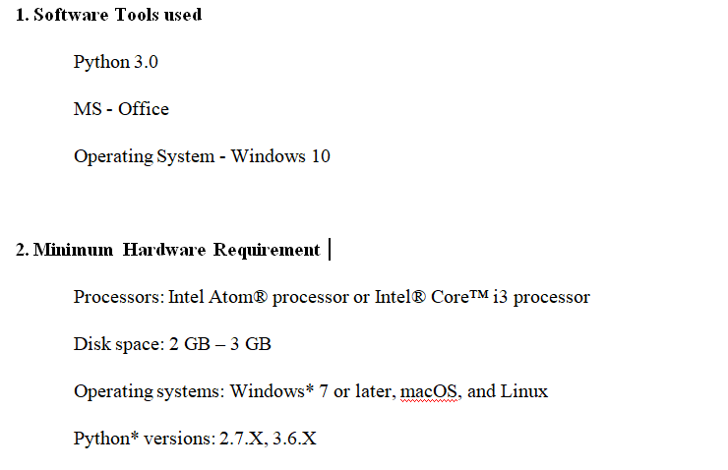
Hardware and Software Requirements and Tools Used

Slide 11
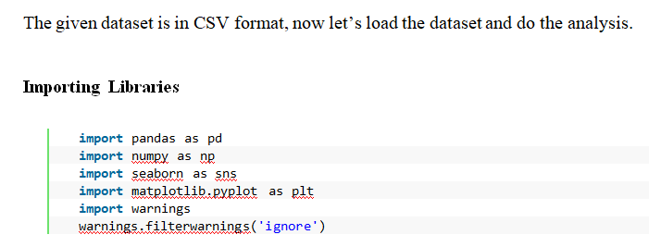
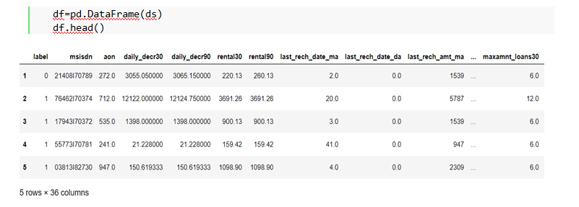
Working with the Dataset

Slide 12
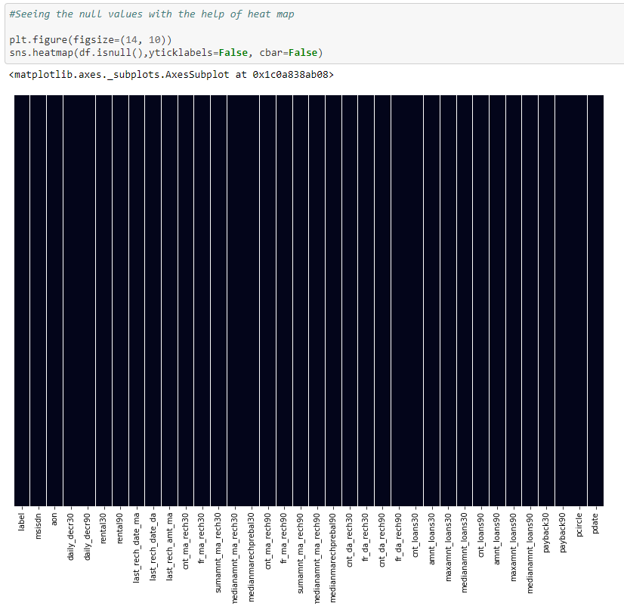
Checking the Null value with the Heat map

Slide 13
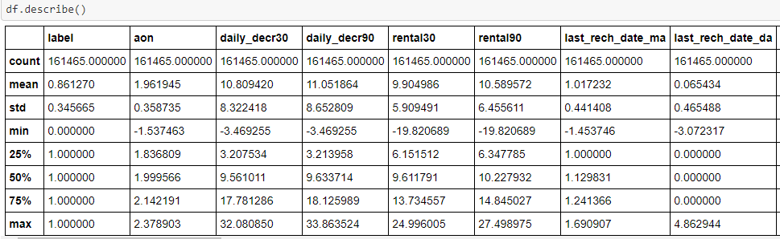
Summary Statistics
In descriptive statistics, summary statistics are used to summarize a set of observations, in order to communicate the largest amount of information as simply as possible. Summary statistics summarize and provide information about your sample data. It tells something about the values in data set. This includes where the average lies and whether the data is skewed.

Slide 14
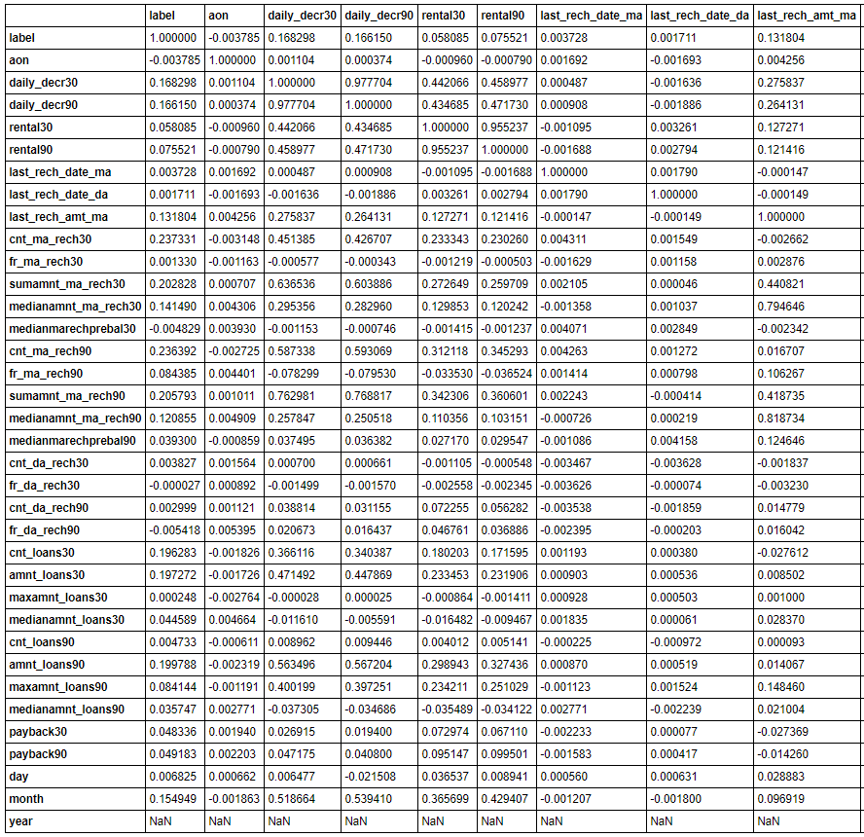
Correlation Factor
The statistical relationship between two variables is referred to as their correlation. The correlation factor represents the relation between columns in a given dataset.

Slide 15
Confusion Matirx
A correlation can be positive, meaning both variables are moving in the same direction or it can be negative, meaning that when one variable's value increasing, the other variable’s value is decreasing.
A correlation matrix is a tabular data representing the ‘correlations’ between pairs of variables in a given dataset. It is also a very important pre-processing step in Machine Learning pipelines. The Correlation matrix is a data analysis representation that is used to summarize data to understand the relationship between various different variables of the given dataset.
Observation
In the Micro Finance Service dataset the correlation graph shows that "daily_decr30, daily_decr90" columns are highly correlated with each other.
2. The columns "cnt_loans30, amnt_loans30" are are highly correlated with each other.
3. The columns "rental30, rental30" are also highly correlated with each other.

Slide 16
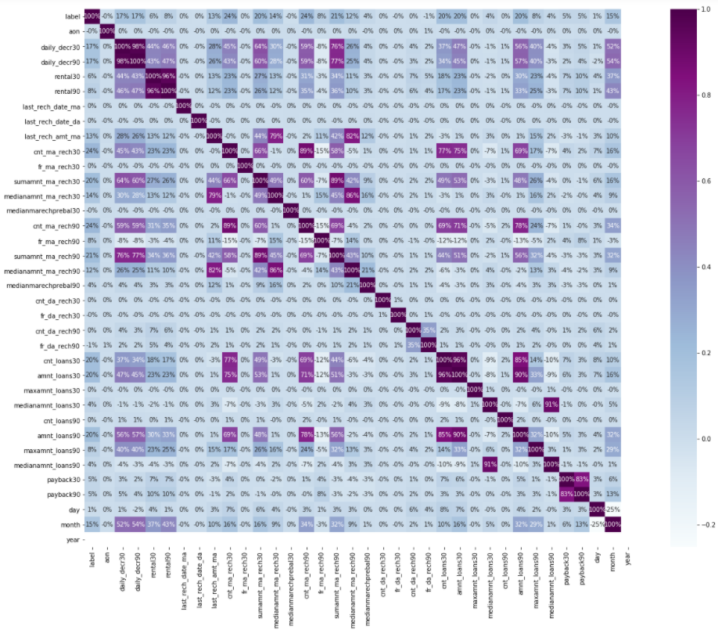
Correlation factor with visualization

Slide 17
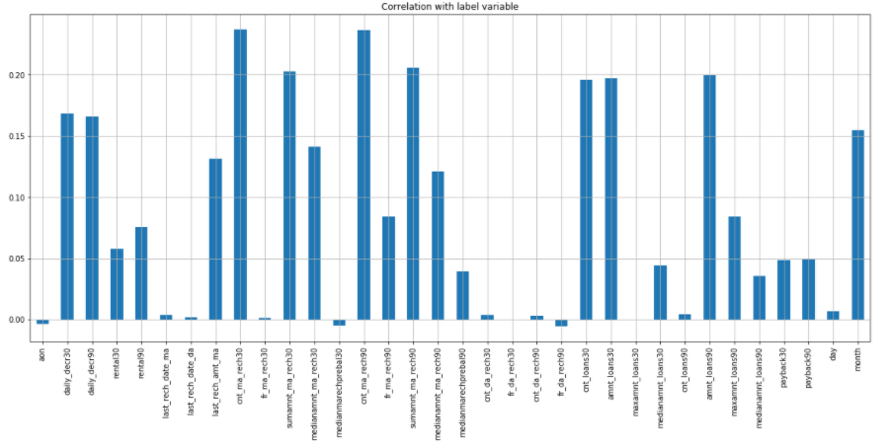
Correlation with target column (label)
Observation
In the Correlation with output column graph we can see that columns “medianmarechprebal30” (Median of main account balance just before recharge in last 90 days at user level (in Indonesian Rupiah) is negatively related with the Output column.
2. The column “fr_da_rech30” (Frequency of data account recharged in last 30 days) in the
dataset is also negatively related with the Output column.
3. All other columns are positively related with the output column and provide significant
importance towards the model building.

Slide 18
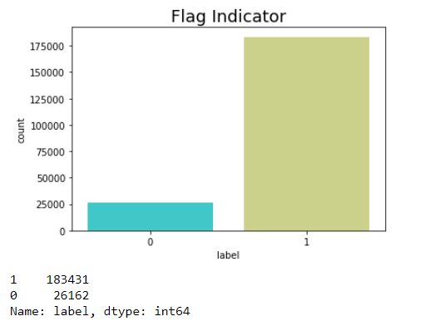
Data Visualization
Flag Indicator
Observation
Out of 209593 cases 183431 are success i.e. user paid back the credit amount within 5 days of issuing the loan.
Out of 209593 cases 26162 are failure cases i.e. failed to user pay back the credit amount within 5 days of issuing the loan.

Slide 19
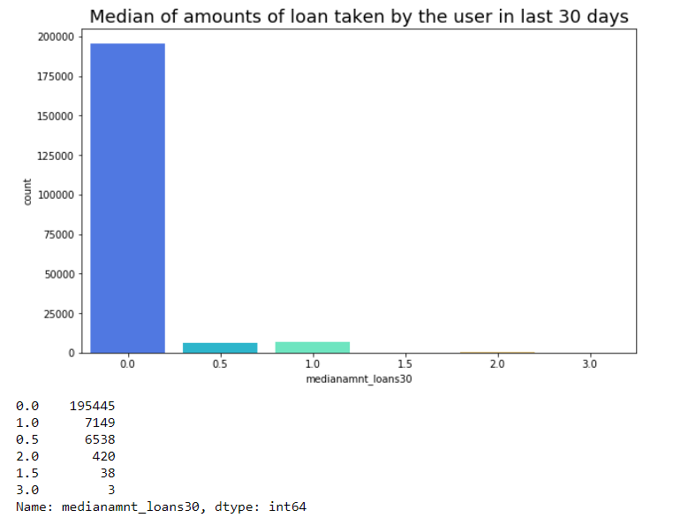
Median of amounts of loan taken by the user in last 30 days

Slide 20
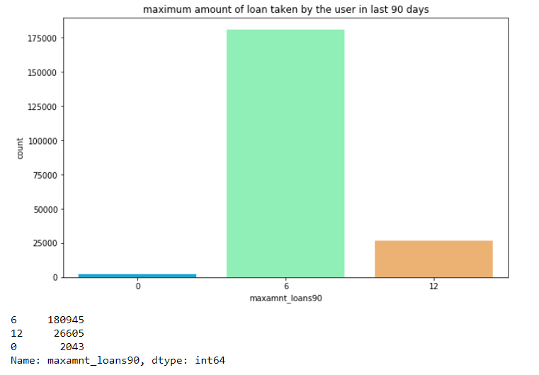
Median of amounts of loan taken by the user in last 90 days

Slide 21
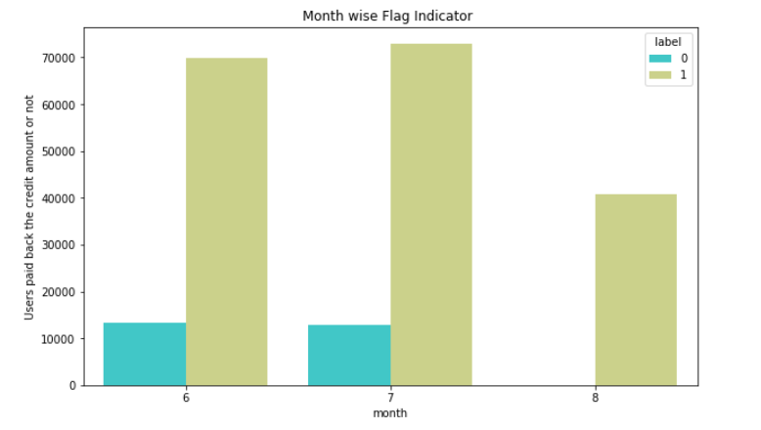
Month wise Flag Indicator
Month Label
June 1 69893
0 13261
July 1 72864
0 12901
August 1 40674

Slide 22
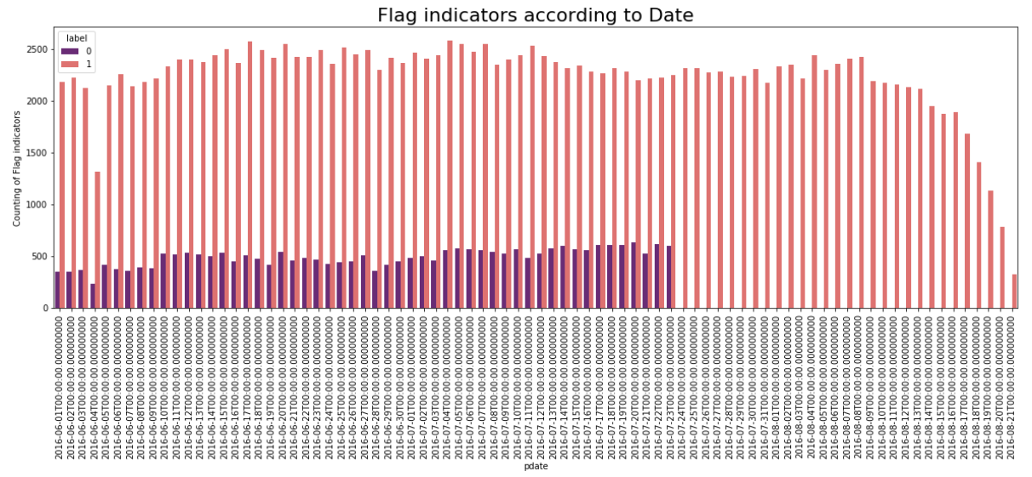
Flag Indicators according to Date

Slide 23
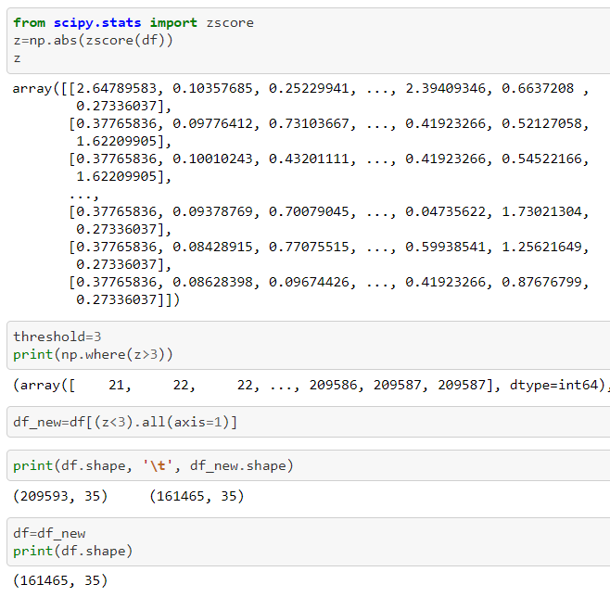
Plotting Outliers
An outlier is a data point in a data set which is distant or far from all other observations available. It is a data point which lies outside the overall distribution which is available in the dataset. In most cases a threshold of 3 or -3 is used i.e if the Z-score value is higher than or less than 3 or -3 respectively, that particular data point will be identified as outlier.

Slide 24
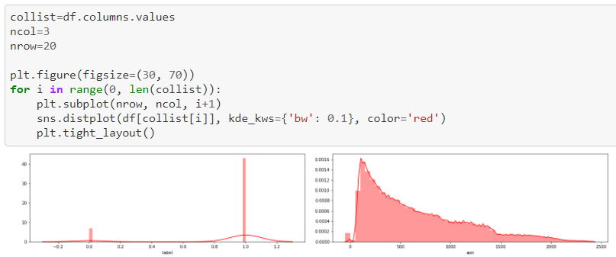
Skewness
Skewness refers to distortion or asymmetry in a symmetrical bell curve, or normal distribution in a set of data. Besides positive and negative skew, distributions can also be said to have zero or undefined skew. The skewness value can be positive, zero, negative, or undefined.

Slide 25
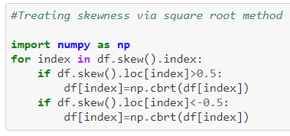
Treaing Skewness via Square root method
The square root, x to x^(1/2) = sqrt(x), is a transformation with a moderate effect on distribution shape: it is weaker than the logarithm and the cube root. So applying a square root transform inflates smaller numbers but stabilises bigger ones. The square root of an area has the units of a length. It is commonly applied to counted data, especially if the values are mostly rather small.

Slide 26
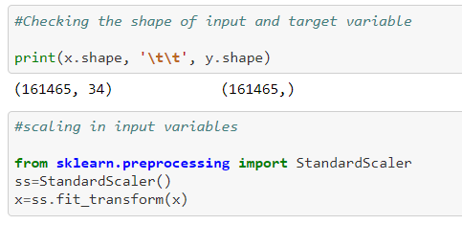
Scaling Input Variables
Standard Scaler - The idea behind StandardScaler is that it will transform the data such that its distribution will have a mean value 0 and standard deviation of 1. In case of multivariate data, this is done feature-wise (in other words independently for each column of the data). Given the distribution of the data, each value in the dataset will have the mean value subtracted, and then divided by the standard deviation of the whole dataset (or feature in the multivariate case).

Slide 27
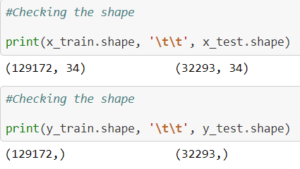
Scaling & Splitting Input Variables
Standard Scaler - The idea behind StandardScaler is that it will transform the data such that its distribution will have a mean value 0 and standard deviation of 1. In case of multivariate data, this is done feature-wise. Given the distribution of the data, each value in the dataset will have the mean value subtracted, and then divided by the standard deviation of the whole dataset.
Train_Test_Split - is a function in Sklearn model selection for splitting data arrays into two subsets: for training data and for testing data. The train_test_split function is for splitting a single dataset for two different purposes: training and testing. The testing subset is for building your model. The testing subset is for using the model on unknown data to evaluate the performance of the model.

Slide 28
Model/s Development and Evaluation
From the given dataset it can be concluded that it is a Classification problem as the output column “label” has binary output “0 & 1”. So for further analysis of the problem we have to import or call out the Classification related libraries in Python work frame.
The important machine learning libraries are.
LogisticRegression
Gaussian Naive Bayes
Decision Tree Classifier
Random Forest Classifier
AdaBoost Classifier
Gradient boosting classifiers
Bagging classifier
Extra Trees Classifier

Slide 29
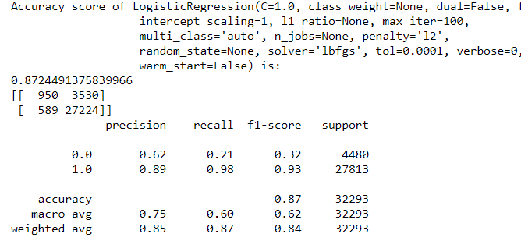
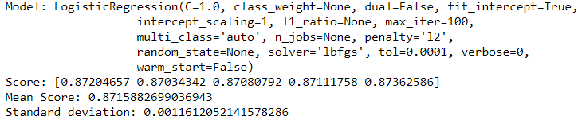
Linear Regression
Logistic regression - is a statistical model that in its basic form uses a logistic function to model a binary dependent variable, although many more complex extensions exist. In regression analysis, logistic regression (or logit regression) is estimating the parameters of a logistic model (a form of binary regression).
Cross Validation

Slide 30
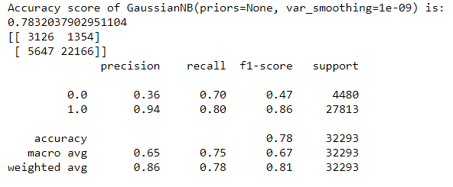
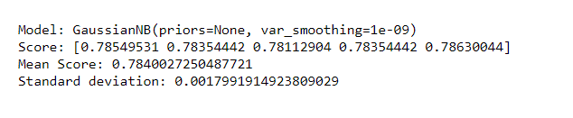
Gaussian Naive Bayes
Gaussian NB- algorithm is a special type of NB algorithm. It's specifically used when the features have continuous values. It's also assumed that all the features are following a gaussian distribution i.e., normal distribution. A Gaussian classifier is a generative approach in the sense that it attempts to model class posterior as well as input class-conditional distribution.
Cross Validation

Slide 31
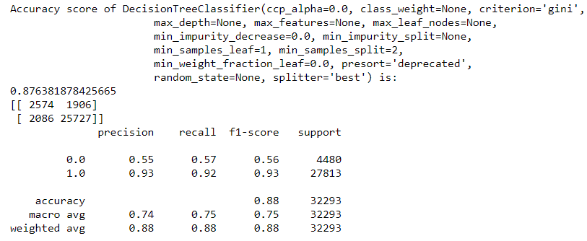
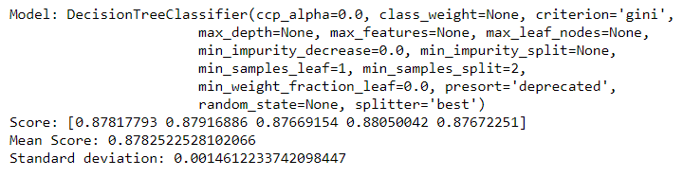
Decision Tree Classifier
Decision Tree Classifier - Decision tree learning is one of the predictive modelling approaches used in statistics, data mining and machine learning. It uses a decision tree to go from observations about an item to conclusions about the item's target value.
Cross Validation

Slide 32
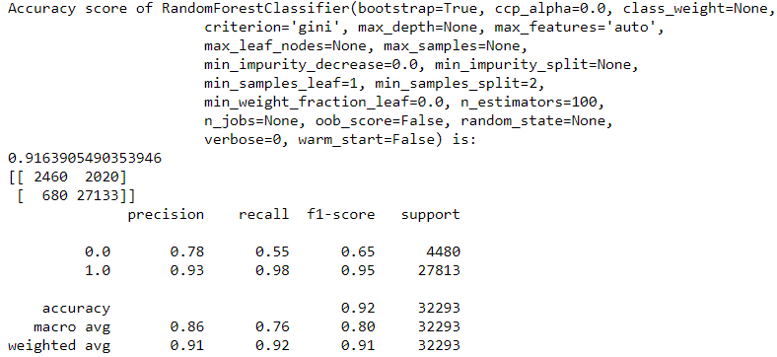
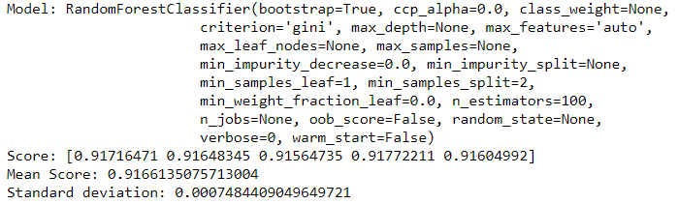
Random Forest Classifier
Decision Tree Classifier Random Forest Classifier - Random forest is a meta estimator that fits a number of classifying decision trees on various sub-samples of the dataset and uses averaging to improve the predictive accuracy and control over-fitting in the dataset. The main concept of Random Forest is to combine multiple decision trees in determining the final result rather than relying on individual decision trees.
Cross Validation

Slide 33
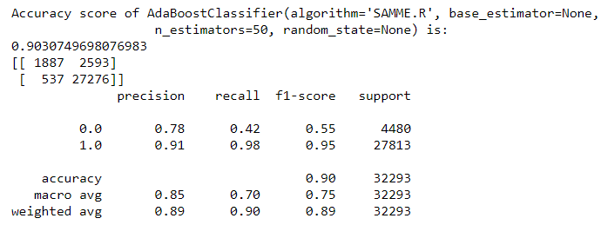
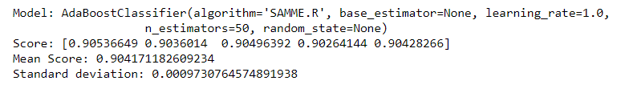
AdaBoost Classifier
AdaBoost Classifier - AdaBoost is best used to boost the performance of decision trees on binary classification problems. AdaBoost was originally called AdaBoost. AdaBoost is adaptive in the sense that subsequent weak learners are tweaked in favor of those instances misclassified by previous classifiers.
Cross Validation

Slide 34
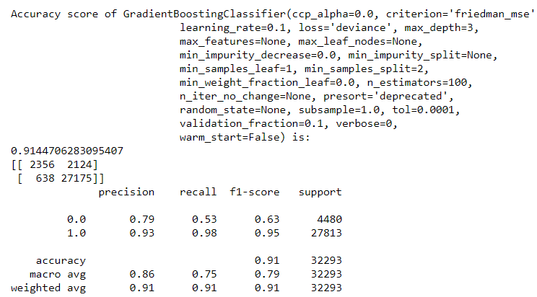
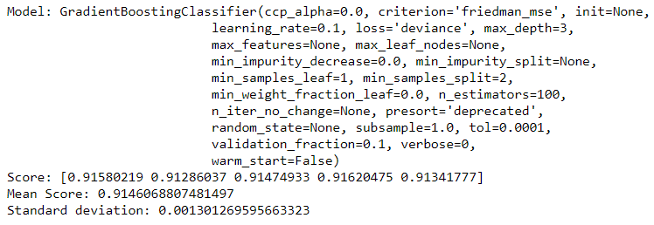
Gradient boosting classifiers
Gradient boosting classifiers - Gradient boosting classifiers are a group of machine learning algorithms that combine many weak learning models together to create a strong predictive model. Decision trees are usually used when doing gradient boosting.
Cross Validation

Slide 35
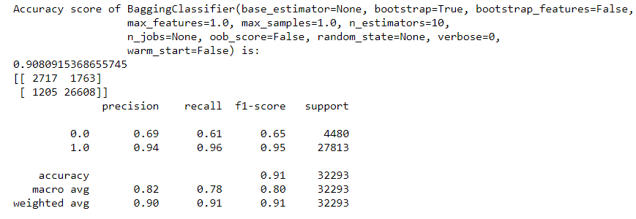
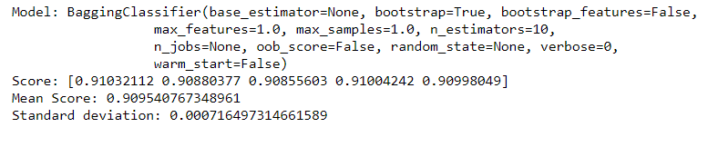
Bagging classifier
Bagging classifier - is an ensemble meta-estimator that fits base classifiers each on random subsets of the original dataset and then aggregate their individual predictions (either by voting or by averaging) to form a final prediction. Bagging is used when the goal is to reduce the variance of a decision tree classifier.
Cross Validation

Slide 36
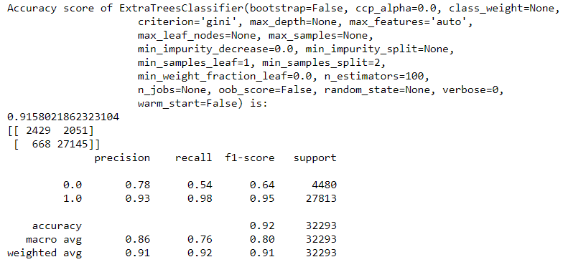
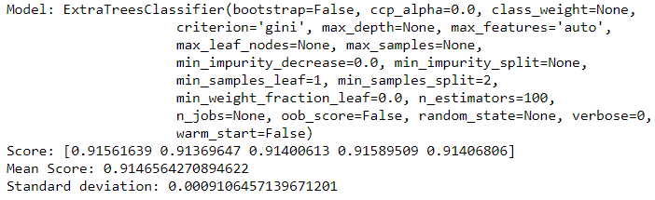
Extra Trees Classifier
Extra Trees Classifier - Extra Trees Classifier, like Random Forest, randomizes certain decisions and subsets of data to minimize over-learning from the data and over fitting. This class implements a meta estimator that fits a number of randomized decision trees on various sub-samples of the dataset and uses averaging to improve the predictive accuracy and control over-fitting.
Cross Validation

Slide 37
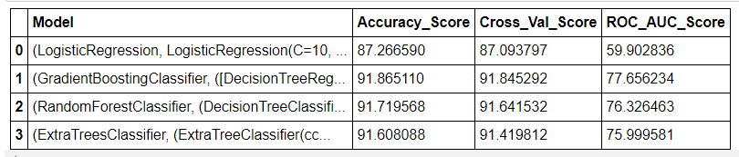
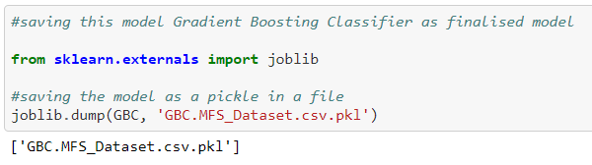
GridSaearch CV
Grid search is an approach to hyper parameter tuning that will methodically build and evaluate a model for each combination of algorithm parameters specified in a grid.
Choosing Finalized Model
The Gradient Boosting Classifier model is working best and can be considered as finalised model.

Slide 38
Conclusion
In the Table it shows that Gradient Boosting Classifier model is working with highest accuracy score of 91.865110
The cross_val_score of model is 91.845292 which again show that cross val score is better compared to other models in the table.
The ROC_AUC_score of the model is showing as 77.656234 which show that model is learning with highest accuracy in the loop compared to other models.
All these points proves that Gradient Boosting Classifier model is working best and can be considered as finalised model.

Slide 39
Learning Outcomes of the Study in respect of Data Science
Credit risk modeling – This allows banks to predict how their loans are going to be repaid and to foresee a defaulter based on history and credit report.
Prediction of Customer Lifetime Value (CLV) – Banks & MFI need to predict future revenues based on inputs from the past. This is best done using predictive data analytics to calculate the future values of each customer.
Deployment of ML models – The Machine learning models can also predict which banking tools individual members might use and recommend them so customers can make better financial decisions.
Fraud Detection – Fraud can be identified by taking measures and then implementing these measures to prevent it from happening again. Ideally, MFI & Banks want to find ways to prevent fraud from taking place, or, if that’s not possible, to detect it before significant damage is done.

Slide 40
Limitations of this work and Scope for Future Work
The production & maintenance of artificial intelligence requires high costs as they are very complex machines, AI consists of advanced software programs that require regular updates to meet the needs of the changing environment in the Banking/MFI sector, In the case of critical failures, the procedure to reinstate the system and recover lost codes may require enormous time & cost.
Although Artificial Intelligence & ML models can learn & improve, it still can’t make judgment calls, Humans can take individual circumstances and judgment calls into account when making decisions. So even though the model can help in the Business outcome but it cannot provide an accurate prediction for individuals.

Slide 41
References
Puja Padhi, “Information and Communication Technology in Microfinance Sector: Case Study of Three Indian MFIs”, IIM Kozhikode Society & Management Review, SAGE Journals, December 10, 2015
Shanthi Elizabeth Senthe, “Transformative Technology in Microfinance: Delivering Hope Electronically”, Research gate, Pittsburgh Journal of Technology Law and Policy, December 13, 2012
Hamed Rahimi Nohooji, “The Classification of the Applicable Machine Learning Methods in Robot Manipulators”, International Journal of Machine Learning and Computing, Vol. 2, No. 5, October 2012
Robert. J. Kauffman, “Information and Communication Technology and the Sustainability of Microfinance”, Electronic Commerce Research and Applications, September 2012
Saon Ray, “The Changing Role of Technological Factors in Explaining Efficiency in Indian Firms”, The Journal of Developing Areas, April 2011

Slide 42
THANK YOU

